Slide 1


December 2022
Improving Medical Imaging Diagnostics Using Computer Vision
Thank you to Andrea and Omer for making this project possible.
Rohit AnUmula
Department of Neuroscience, College of Natural Sciences, The University of Texas at Austin

Slide 2
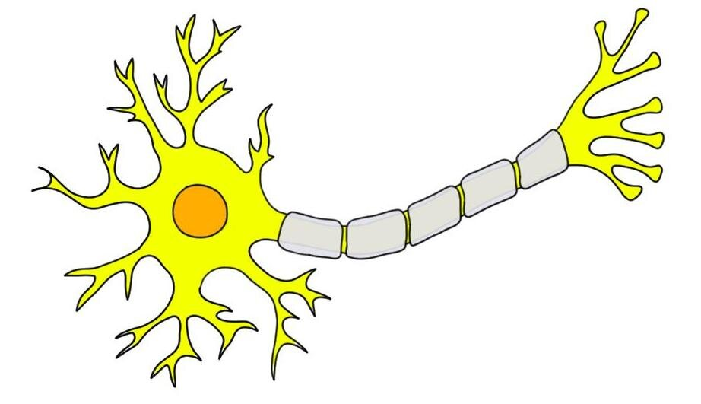
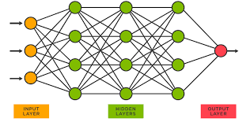
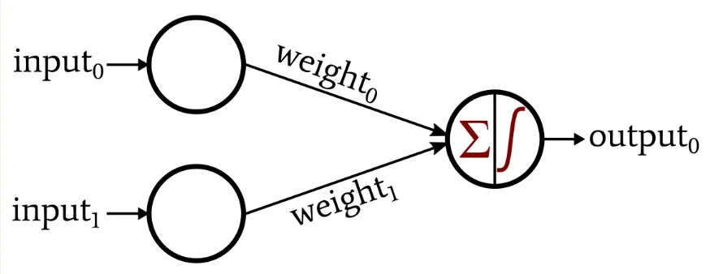
Introduction
Neuron -> Perceptron -> Neural Network
Notes:
One sent perceptron

Slide 3
Different Types of Neural Networks Have Different Use Cases
Recurrent Neural Networks
Speech and Voice recognition
Convolutional Neural Networks
Robust image classification
Deep Convolutional Neural Networks

Slide 4
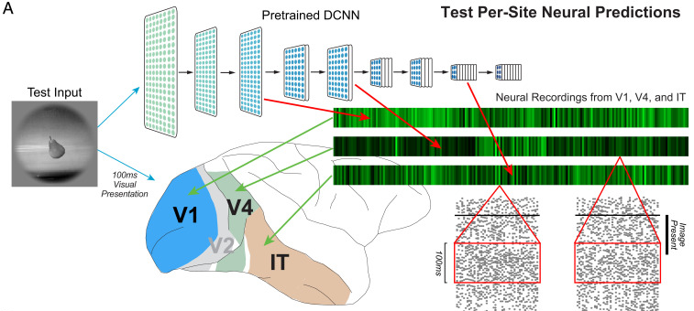
Neural Networks can model connections in the brain
Vision
Predicting vs. explaining phenomena

Slide 5


How a CNN works

Slide 6
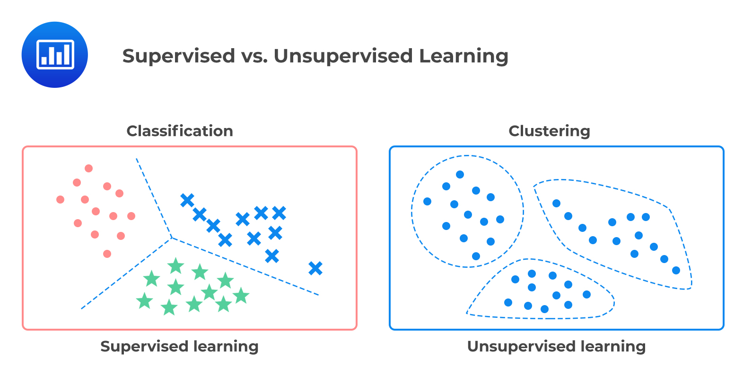
Techniques to Improve Computational Efficiency
Padding and Striding
Supervised and
unsupervised learning
Adjustment of
Hyperparameters

Slide 7
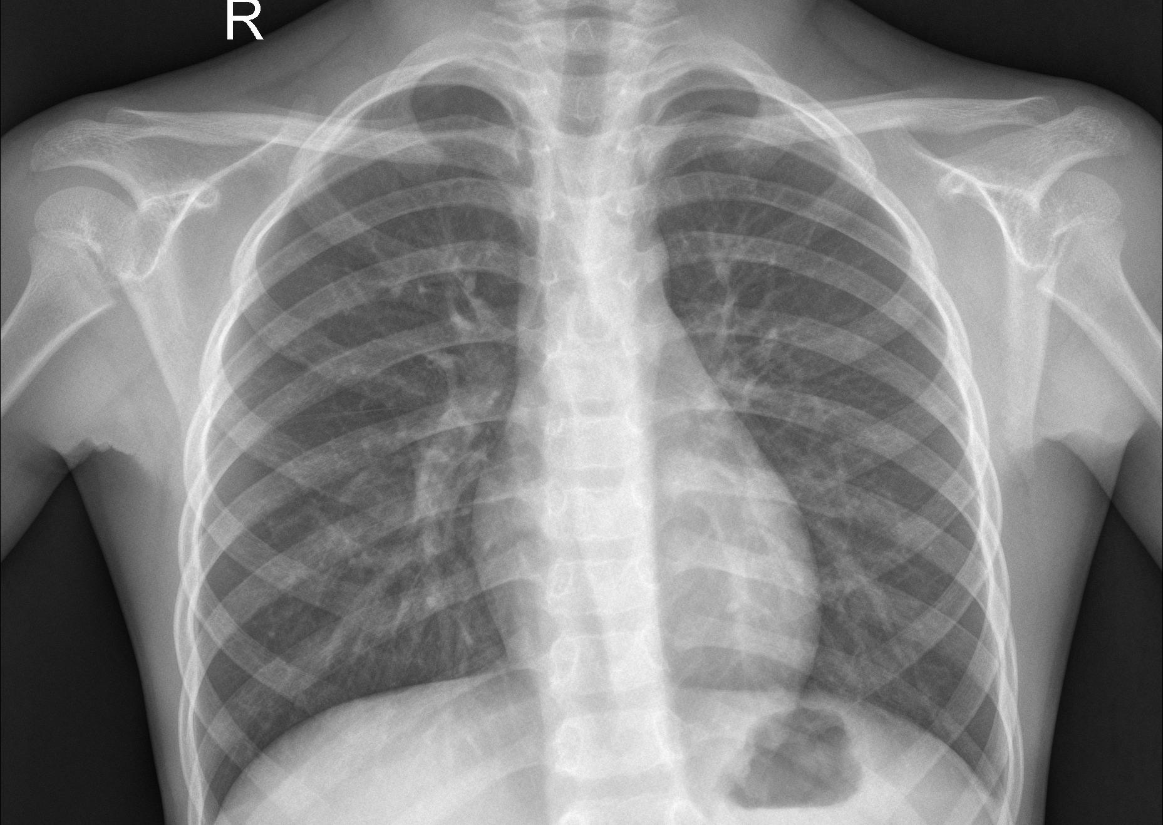
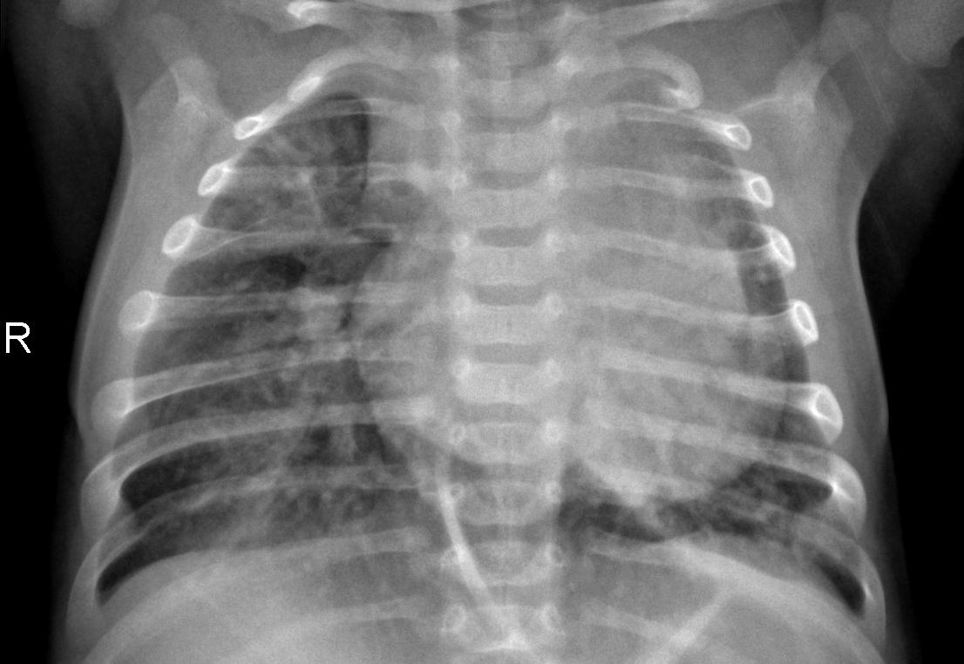
Application of CNN’s in Medical Diagnostics
Normal Lungs
Pneumonia Lungs

Slide 8
Ethics and Future Directions
Racial Biases
Privacy
Synthetic Models
Diagnose many disorders
Better understand radiologist diagnostics
Notes:
Explain neon people well
Add

Slide 9
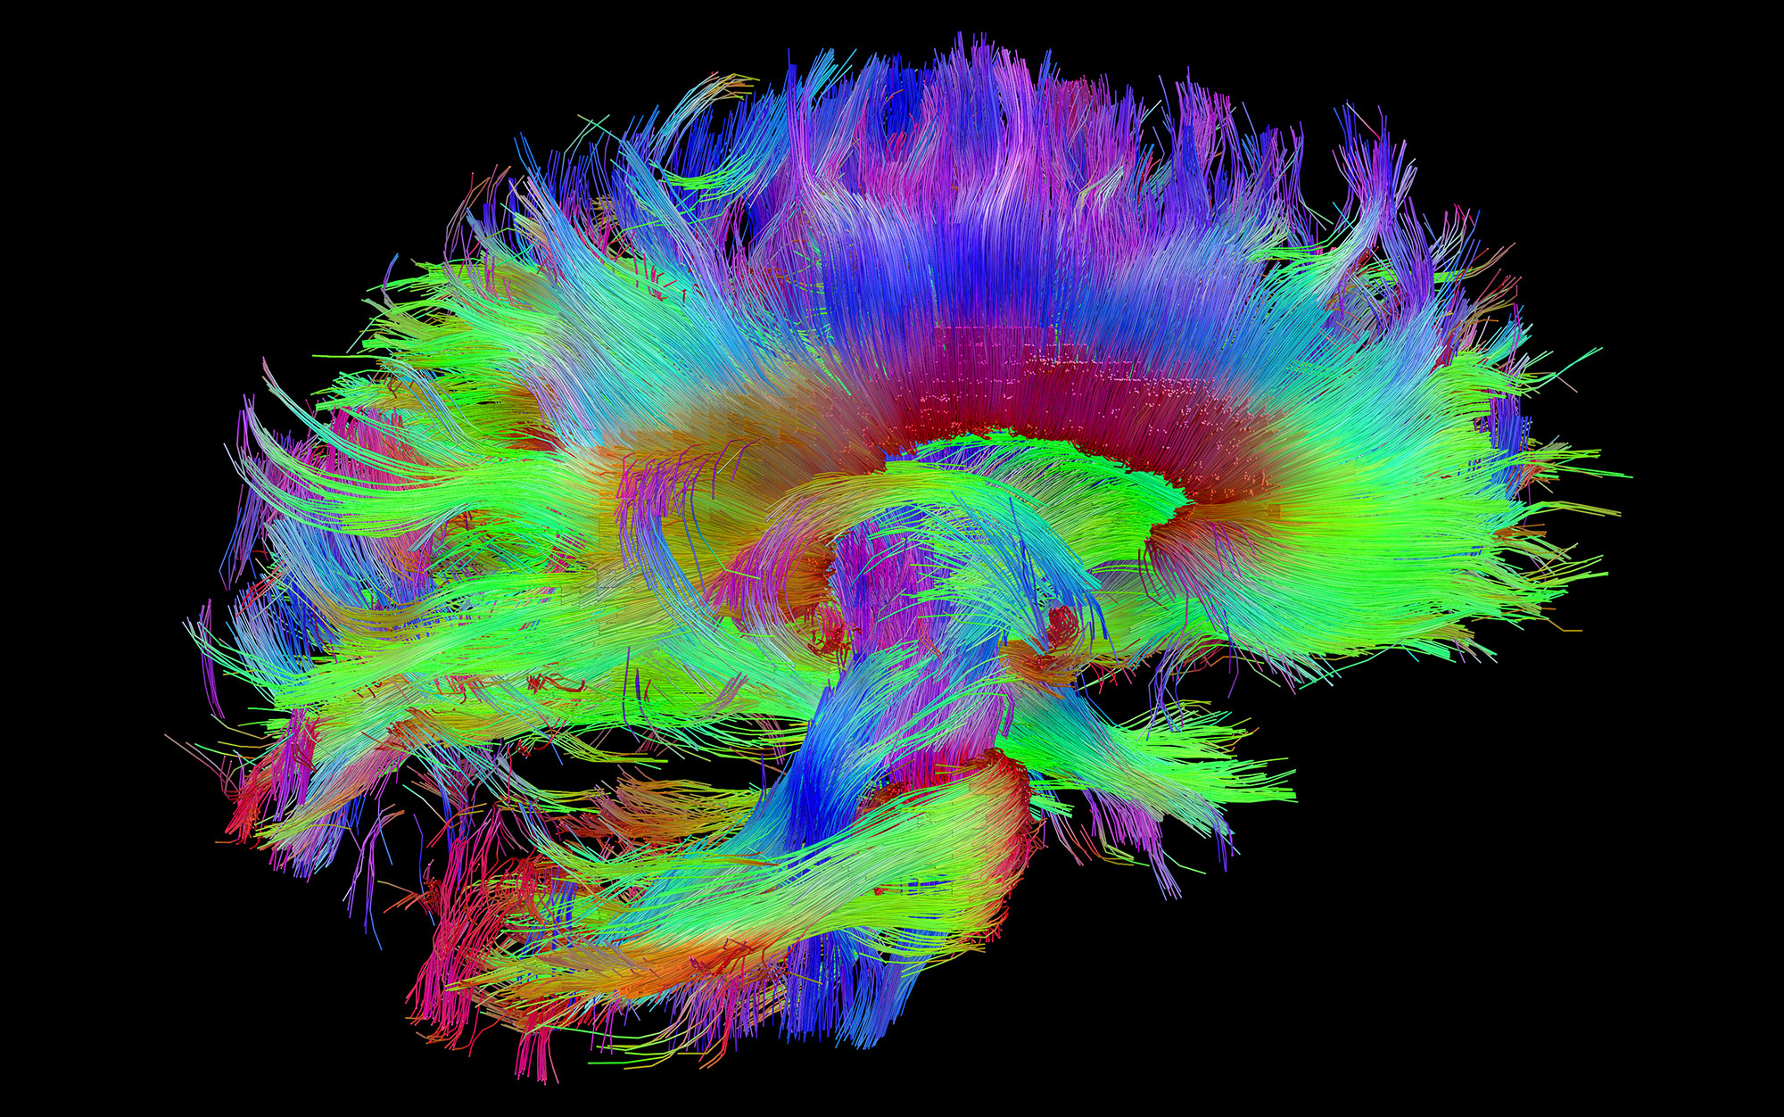

Thank You!
Any Questions?

